Slide 1



Overview
Swiggy For Work (SFW)
Eliminating Reimbursements, Enhancing Efficiency
Transform how your organization manages employee meal benefits with a streamlined, digital-first solution that saves time, reduces administrative burden, and improves employee satisfaction.
In partnership with

Slide 2
Traditional meal reimbursement processes create friction for everyone involved. Our solution eliminates these pain points entirely.
Traditional process
Pain points
Manual Processing Burden
Employees spend valuable time collecting receipts, filling out forms, and submitting expense reports for every meal purchase.
Long cycle of reimbursements
Finance teams face bottlenecks processing hundreds of meal claims monthly, leading to payment delays that frustrate employees.
Lack of real time insights
HR and Finance lack real-time insights into meal spending patterns, making budget planning and policy enforcement challenging.
Employee uses food delivery app or dines out to use meal budget
Employee pays through personal payment mode
Employee uploads the meal bills on company portal
Meal bills are validated and claim is disbursed to employees in monthly payment cycle

Slide 3






SFW solves for multiple use cases - Dining out at restaurants or Food ordering in office
Employees
HR/ Admin
Meals at hotel or restaurants while travelling
Celebrations & town halls
Late night meals at office
Client & team meetings
Team dinners at restaurants
Hiring drives & trainings

Slide 4
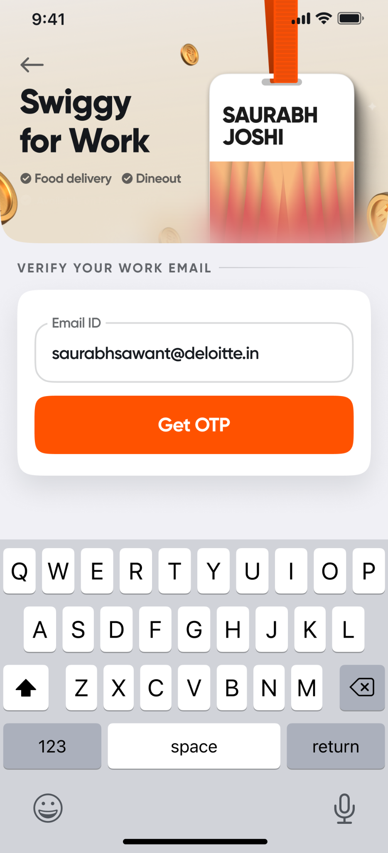
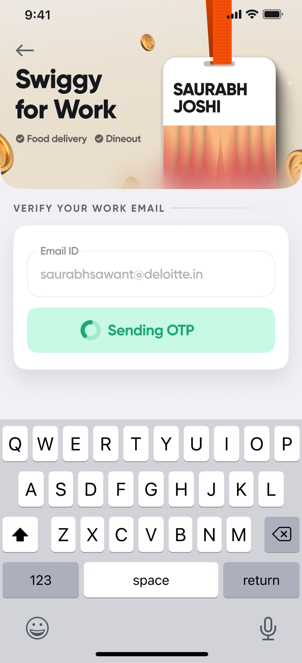
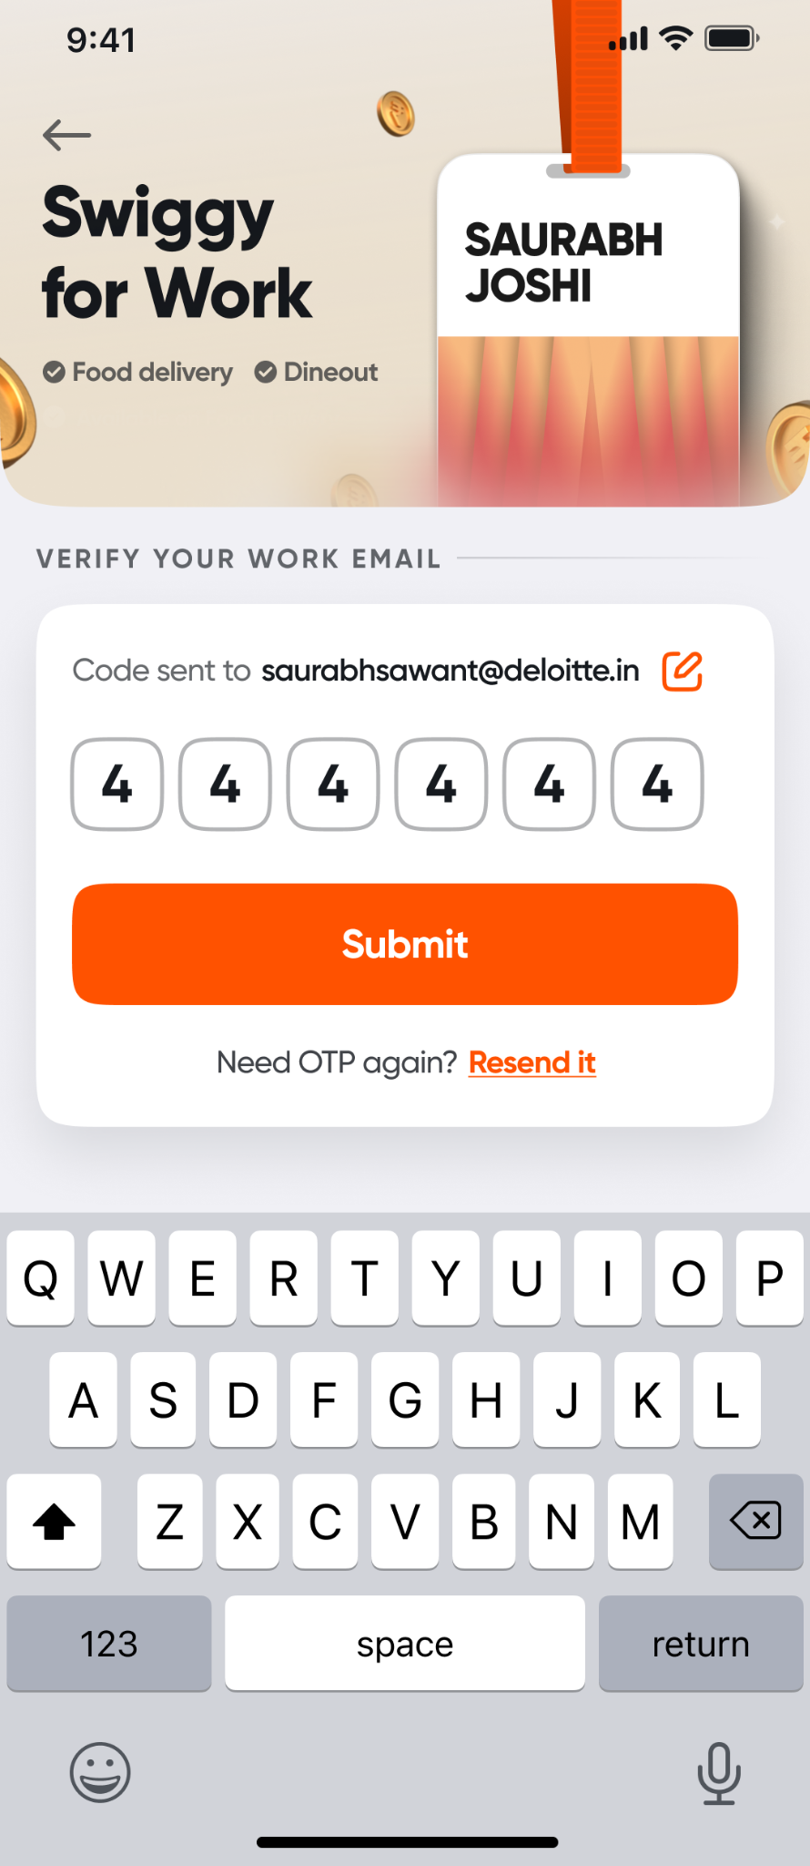
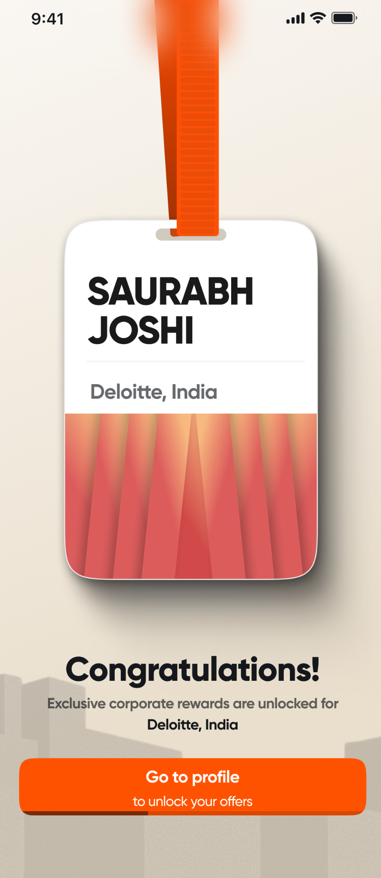
How it works? Employees log into Swiggy via corporate email ID

Slide 5
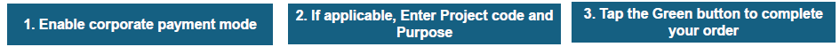
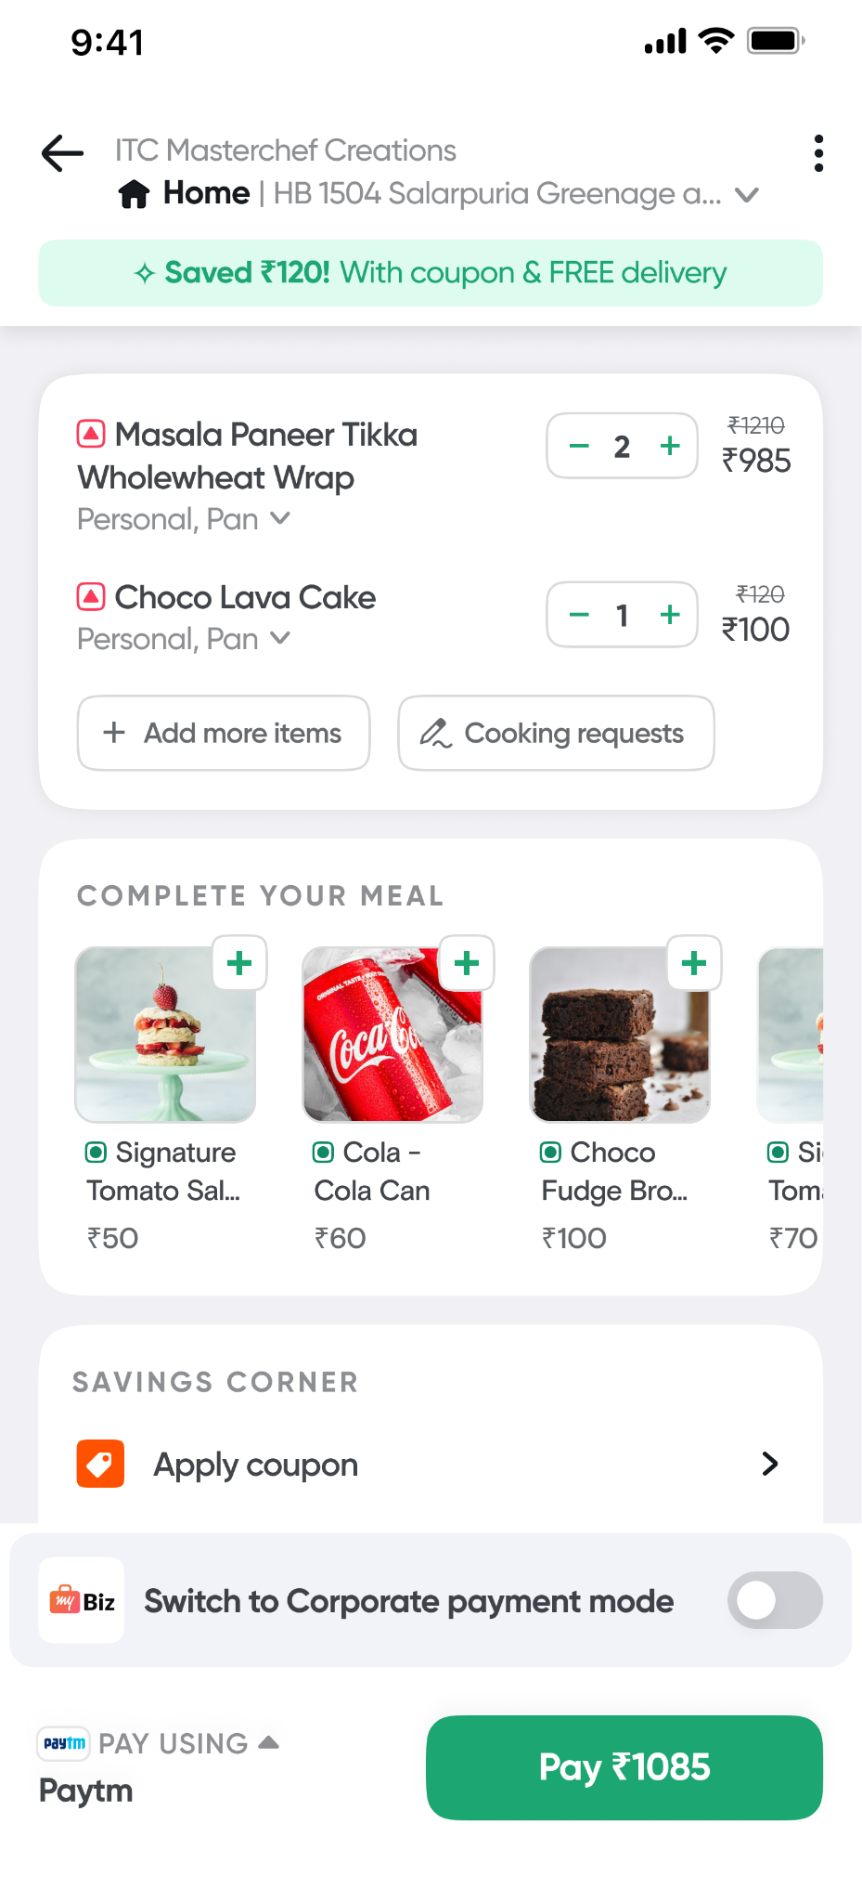
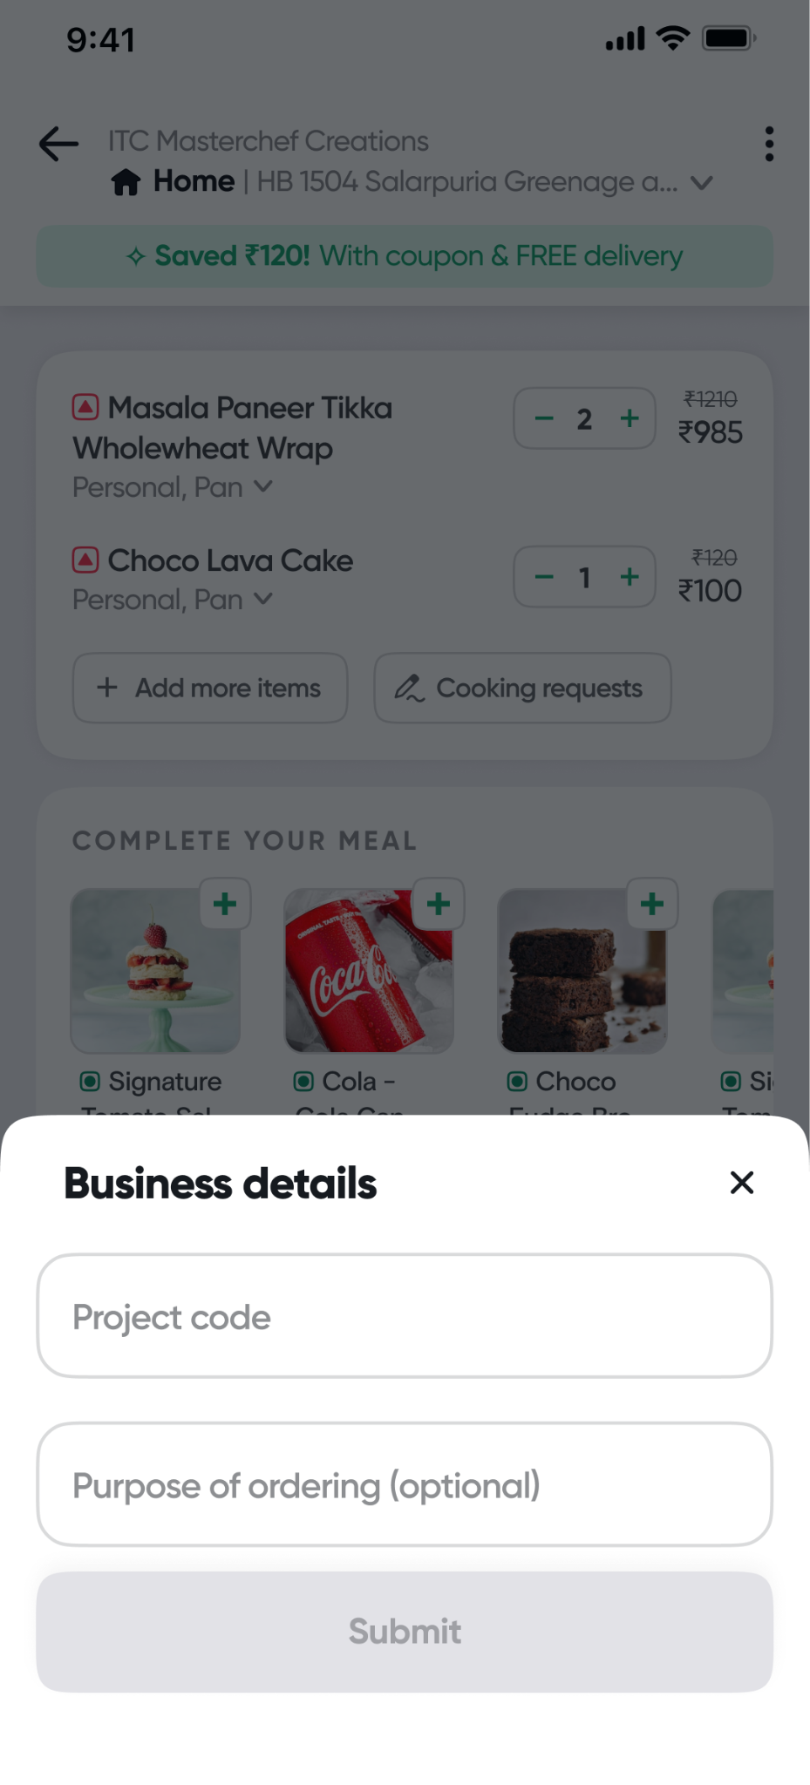
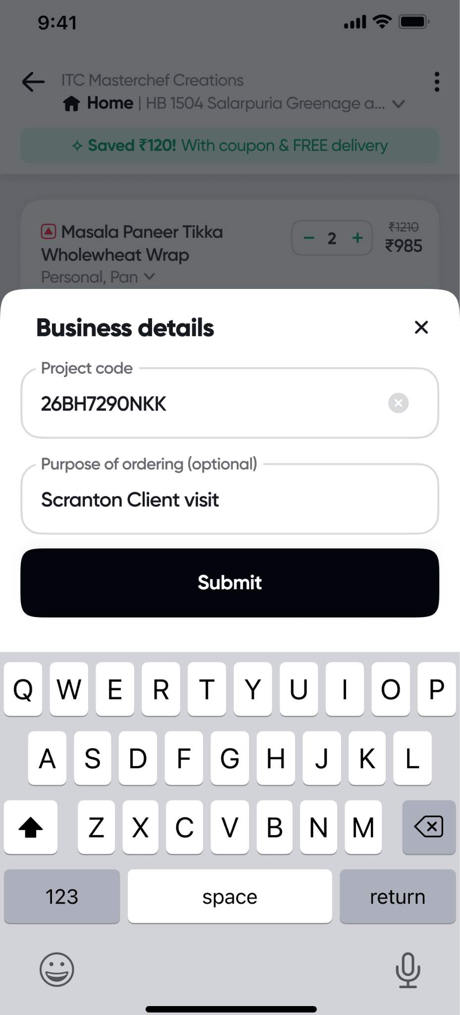
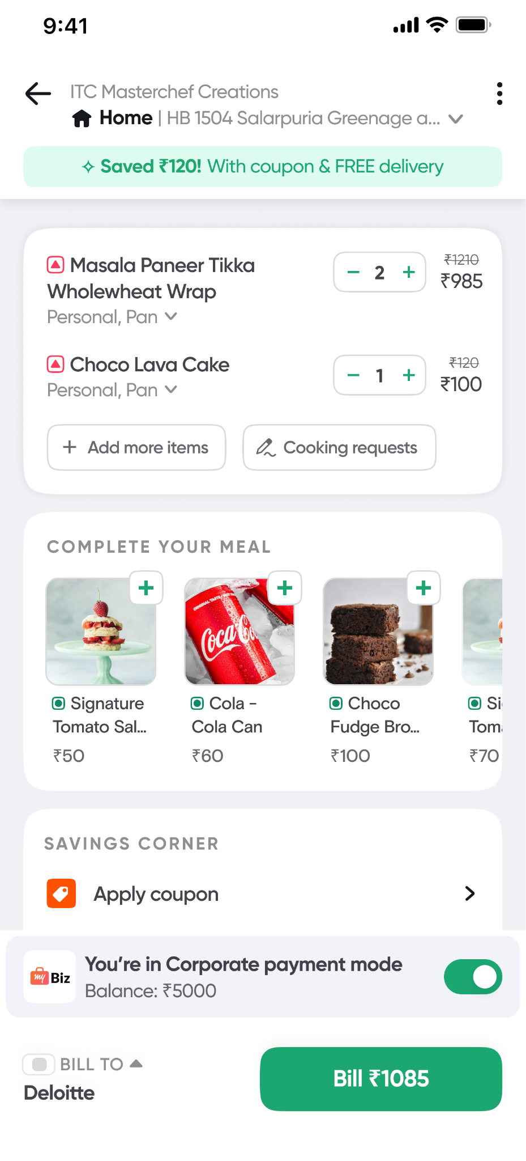
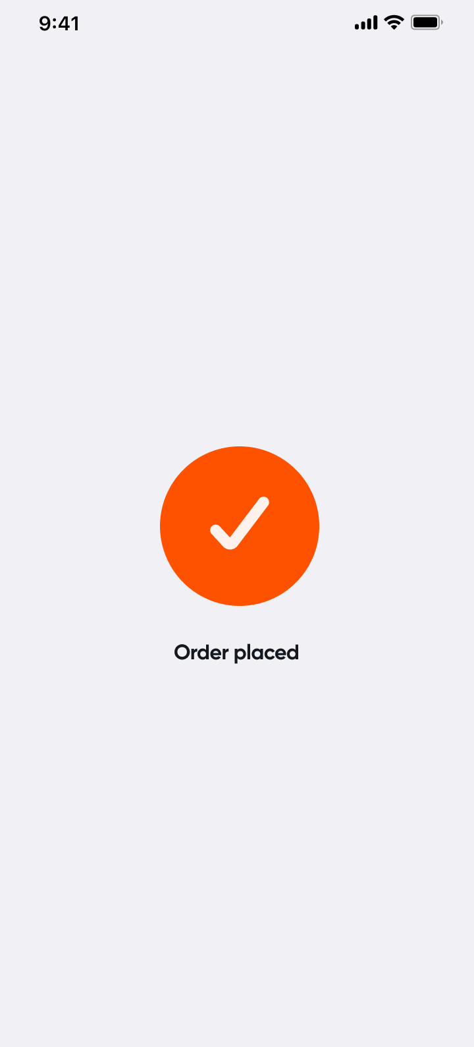
How it works? Employees add items to cart using normal flow on Swiggy food delivery app but choose “Corporate Payment” as mode on cart page
Balance available in corporate mode

Slide 6
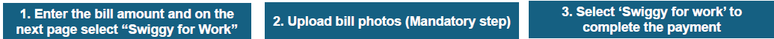
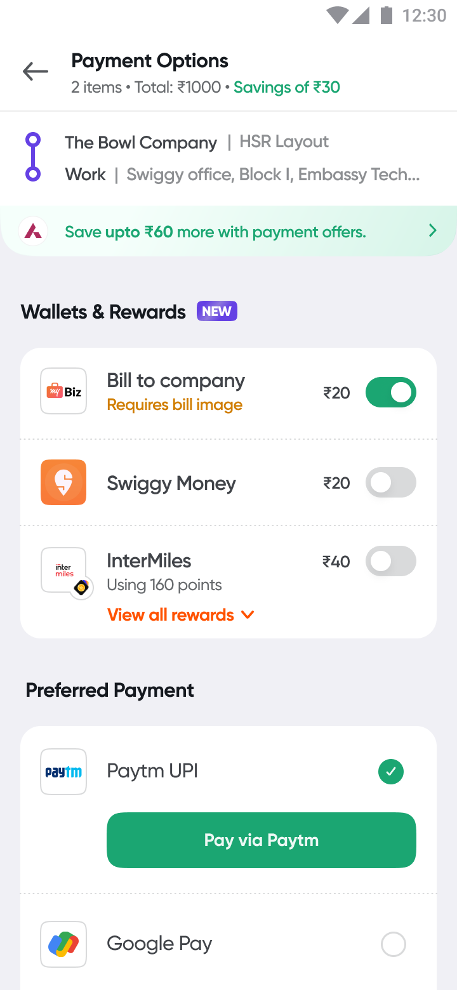
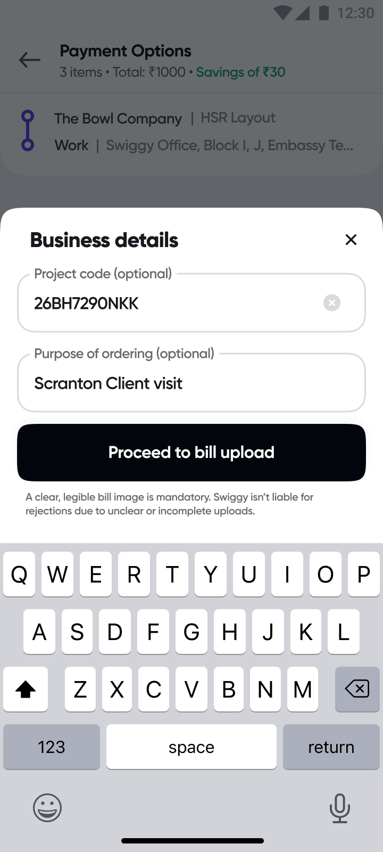
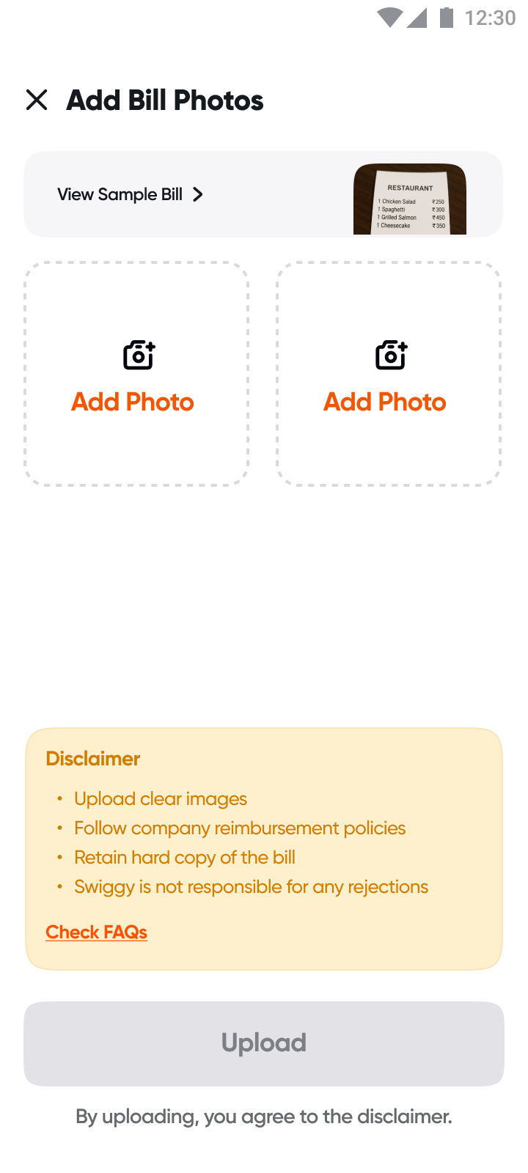
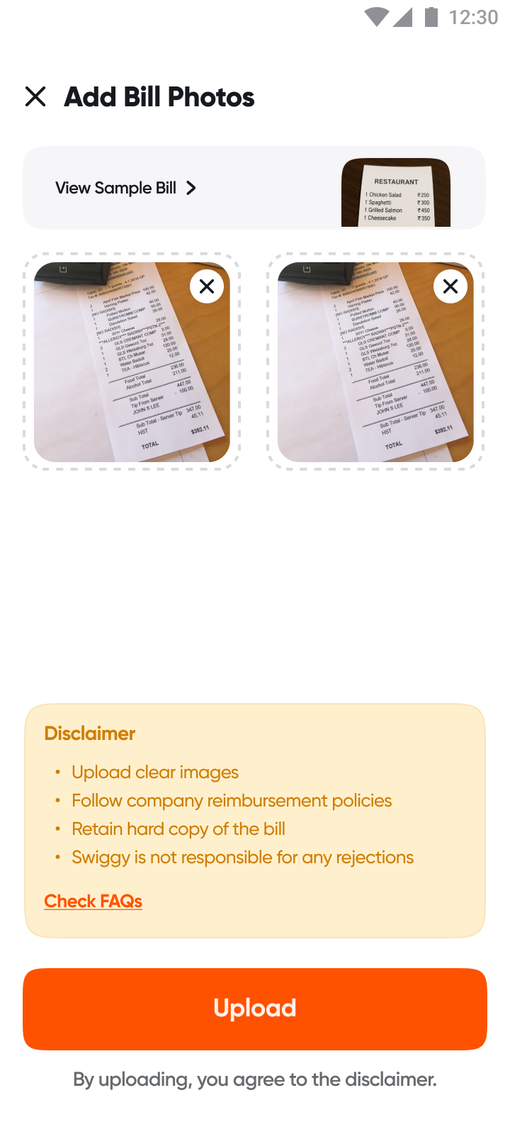
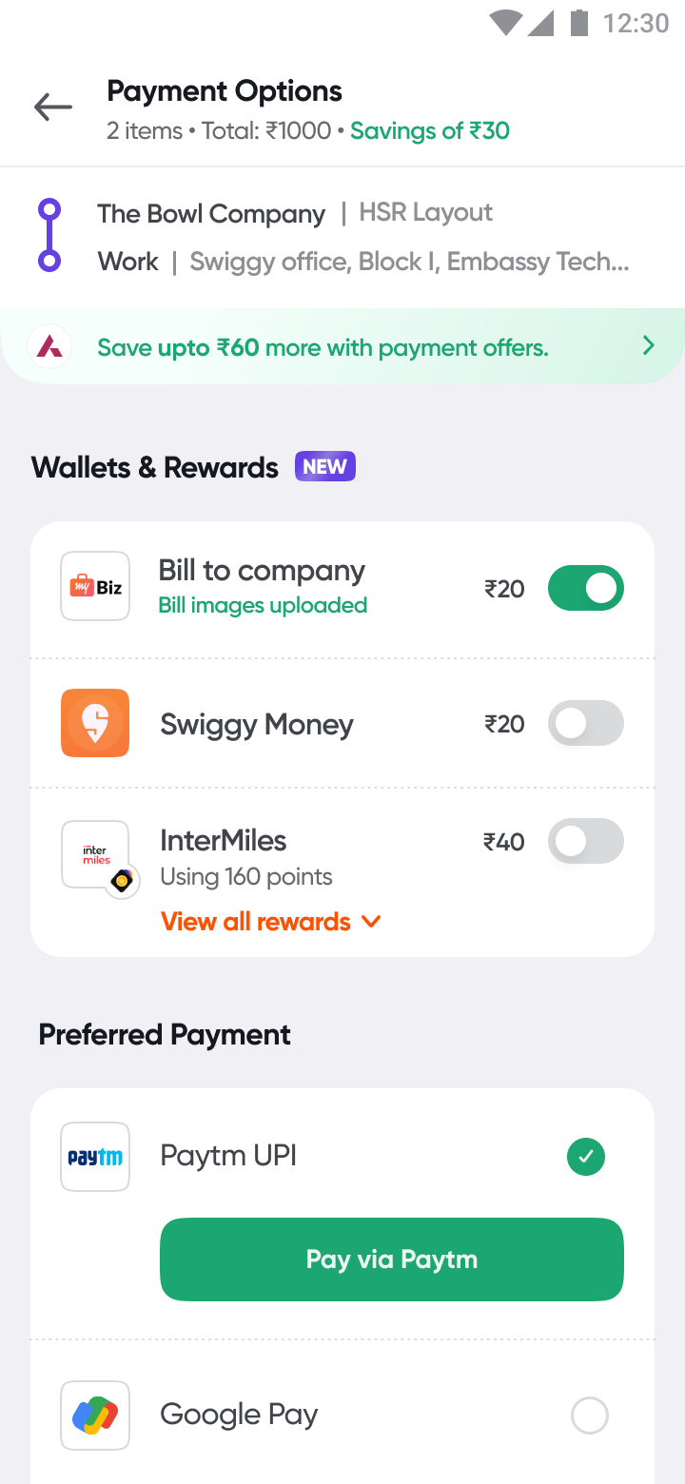
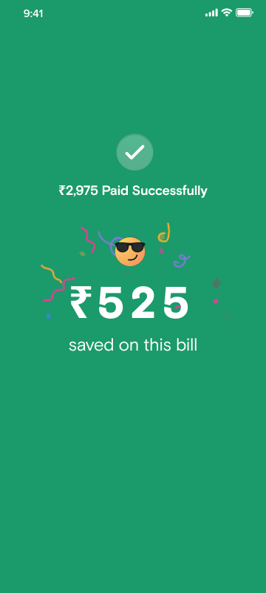
How it works? On Dineout, employees select “Bill to company” on payment page, fill details and attach bill screenshots to make payment

Slide 7
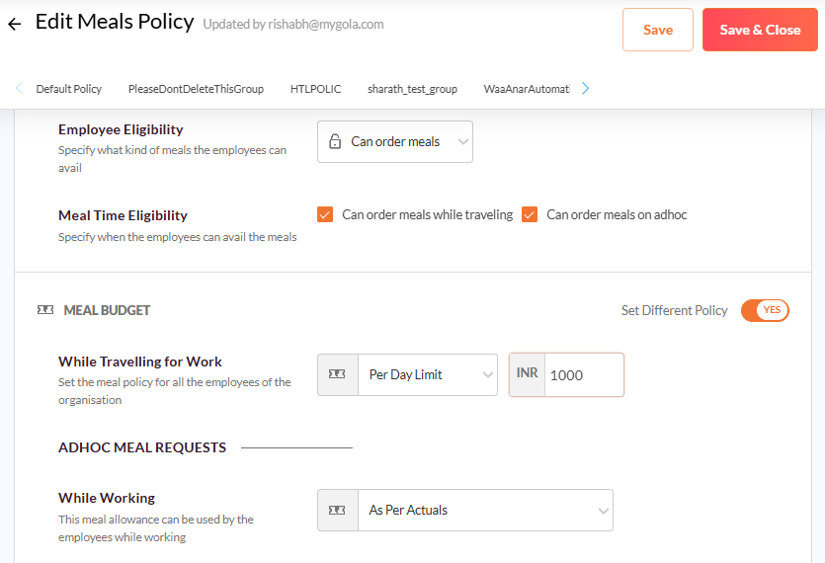
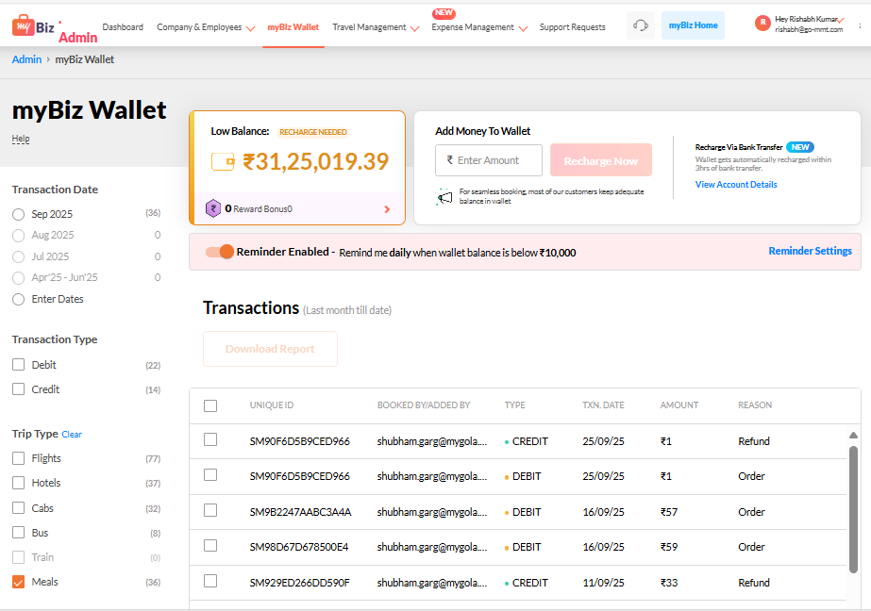
Admin side interface
Easy Policy Set up
Wallet usage report
Enable spend limits by employee groups
Real time usage of wallet visible

Slide 8
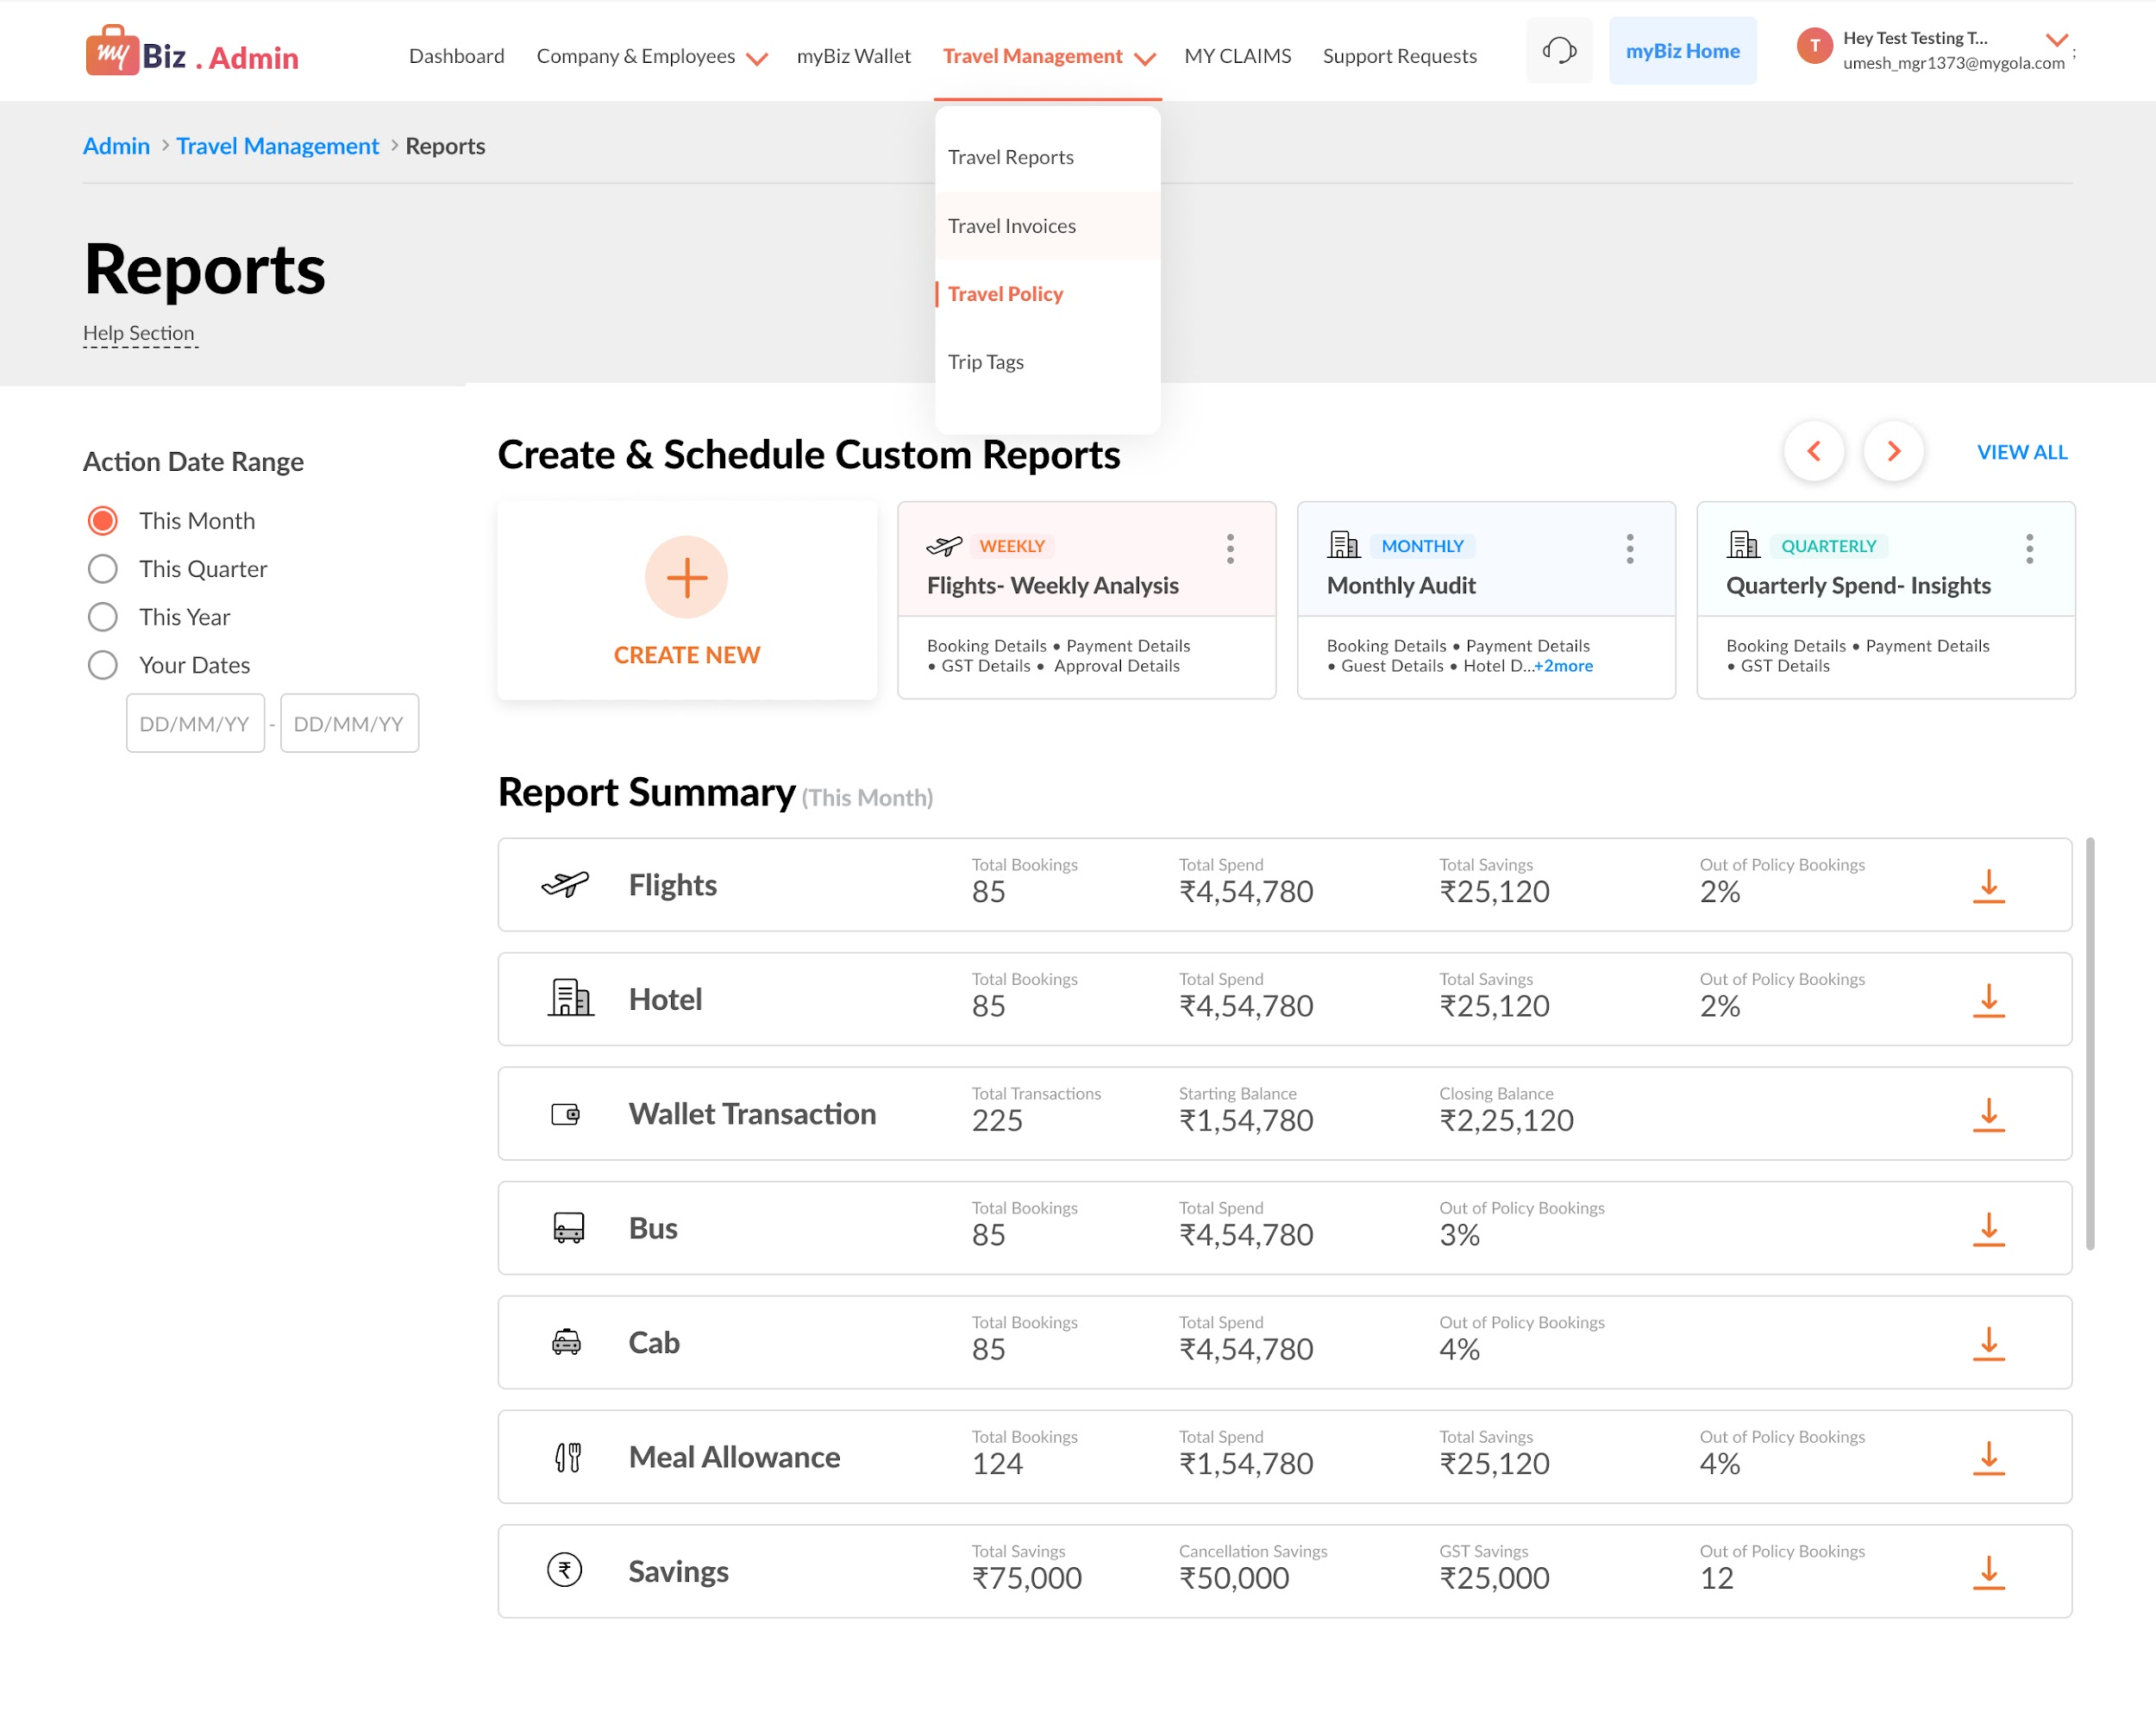
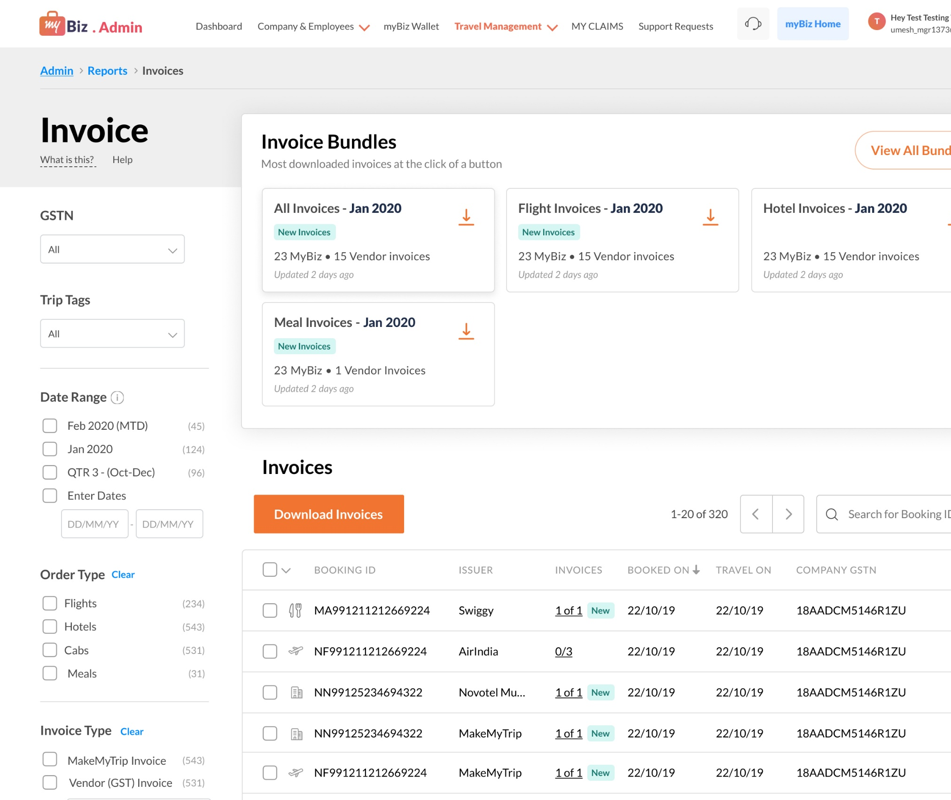
Create customized reports and download invoices
Meal reports
Meal invoices

Slide 9
What our users say..
Employees
HR/ Admin
“Getting a proper GST bill in a small town used to be impossible. I’d end up with handwritten notes that finance wouldn’t accept. Now, it’s all handled in the app.”
- Piyush, Business Development Manager. MakemyTrip
My main headache was tracking a lot of invoices every month. It was a mess. Now, it’s just one single monthly invoice. It’s made the whole process so much faster & smoother."
- Ajay, Admin, KFintech
“The main issue for me was the anxiety around credit card bill dues because of the reimbursement process. At times, I had to pay from my own pocket and just wait, that’s gone now.”
- Jay, Sr. Business Development Manager, MakemyTrip
“When we order food for small office events, seeing the monthly limit right at checkout helps a lot. We don’t have to keep a track of it.”
- Admin, WeWork

Slide 10
Unparalleled convenience for our users
HR/ Admin
Employees
Simpler invoicing: Single monthly invoice reduces effort
Lower admin ops: Reimbursements and bill verification automated
Budget control: Centralized billing with real time visibility on spend limits
Reduced Credit Card Hassle: Less reliance on managing corporate credit cards payments.
No out-of-pocket spends: Reimbursements eliminated
Zero reimbursement friction: No bills, submissions, or follow-ups.
Improved compliance: GST billing issues resolved, even in smaller cities.
Stress-Free Employee Experience: Especially valuable for traveling employees
Seamless Integration: Wallet auto-activates with MyBiz hotel bookings.

Slide 11





Some of our clients
WeWork
Translumina
MakeMyTrip
KFin Tech
Quess Corp

Slide 12

Thank You
Ready to transform your workplace dining experience? Let's connect and discuss how Swiggy@Work can meet your organization's unique needs.
Get in Touch
Ayush Arora ayush.arora@swiggy.in General Manager, Swiggy Food +91 9999783697
Nishtha Manchanda nishtha.manchanda@swiggy.in Director, Swiggy Food +91 8010509024

